Slide 1
You’re listening to…
the HIST 190 playlist from songs you submitted on the chatboard! Still want to contribute? Post your song in the “music and memes” channel on the chatboard!

Slide 3
QUESTIONS???
Raise your hand at any time!!

Slide 4
HIST 190 – What you need to know!

Slide 5
WHO?

Slide 6
PROFESSOR
Dr. Dana Wessell Lightfoot
PhD History – University of Toronto
MA in History – University of Toronto
BA in History and English – University of Toronto

Slide 7
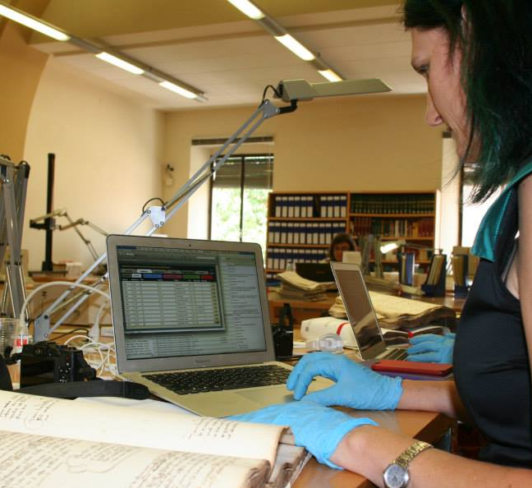
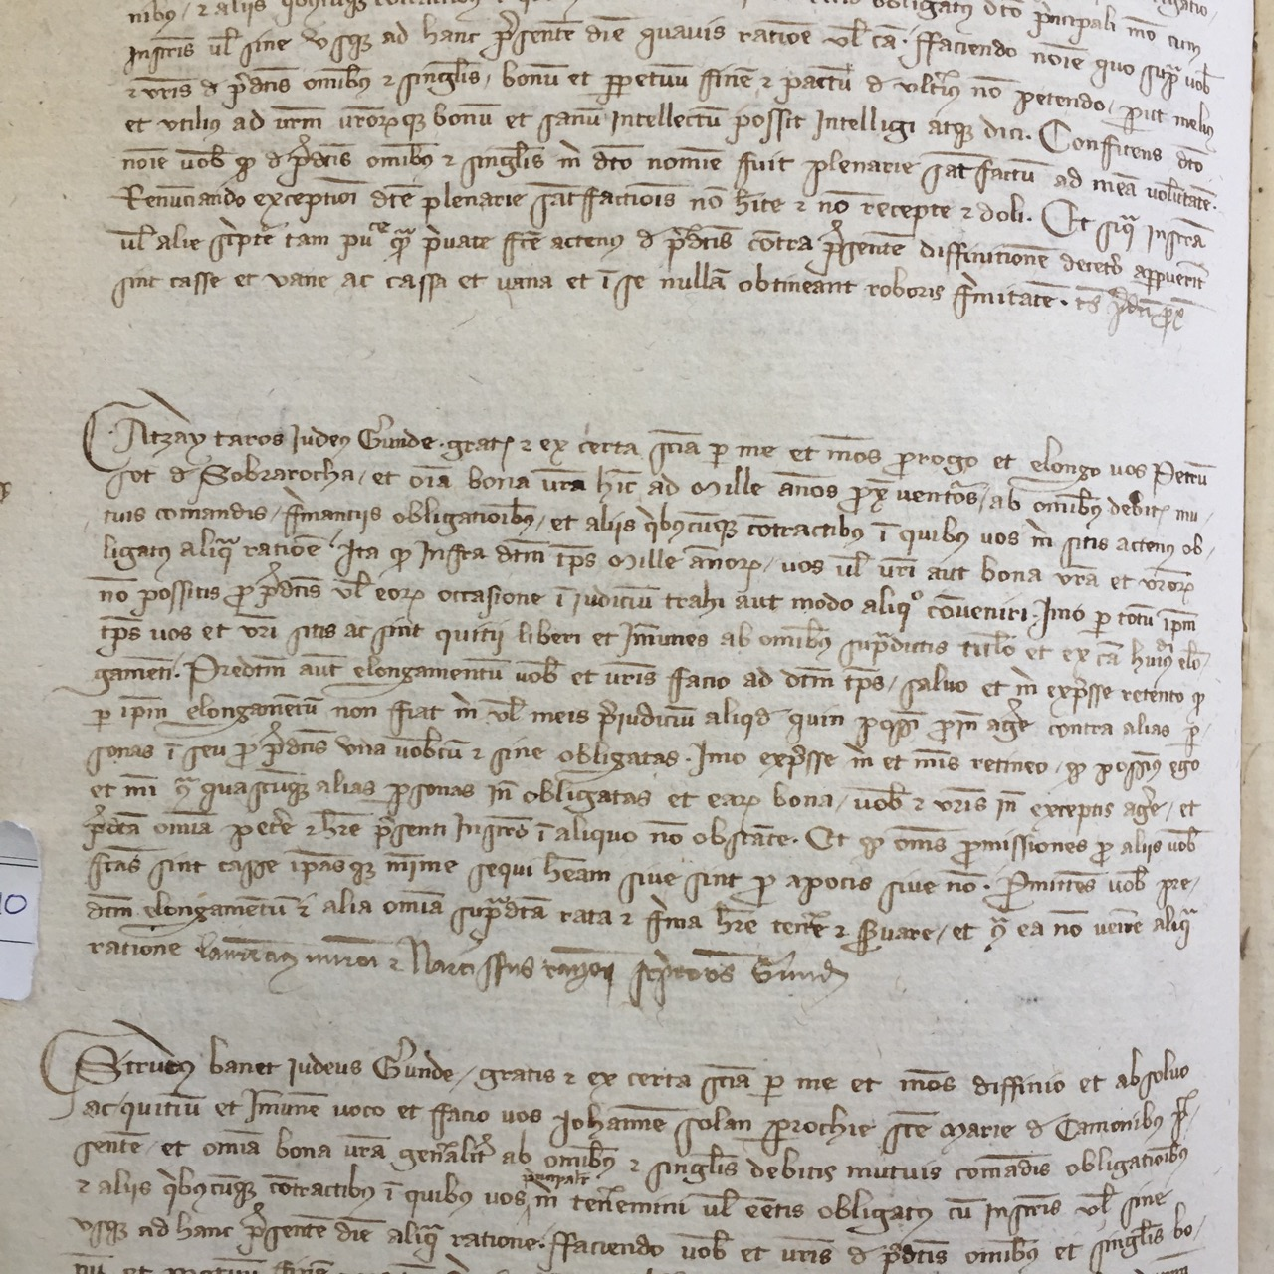
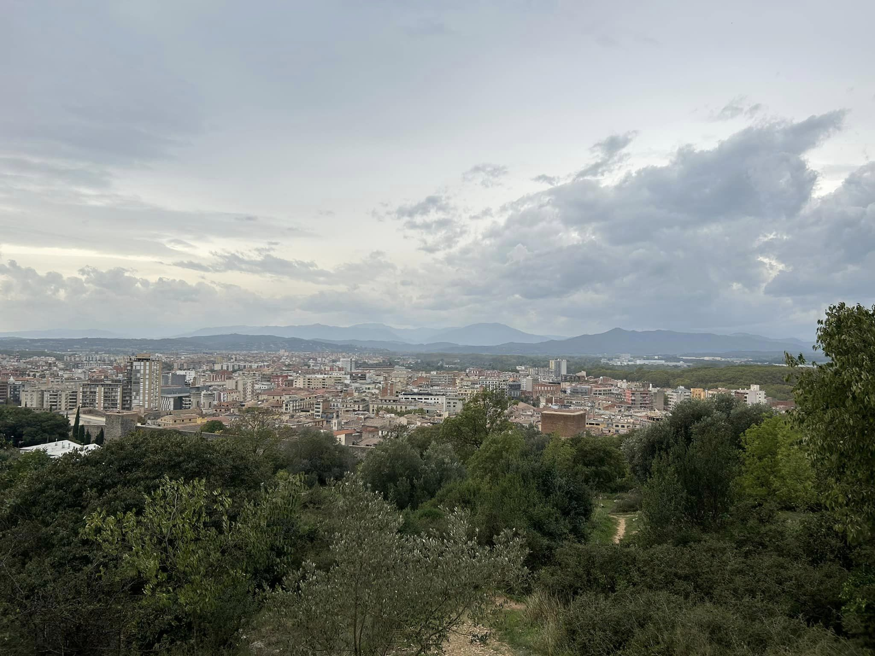
Research
GIRONA, SPAIN

Slide 8
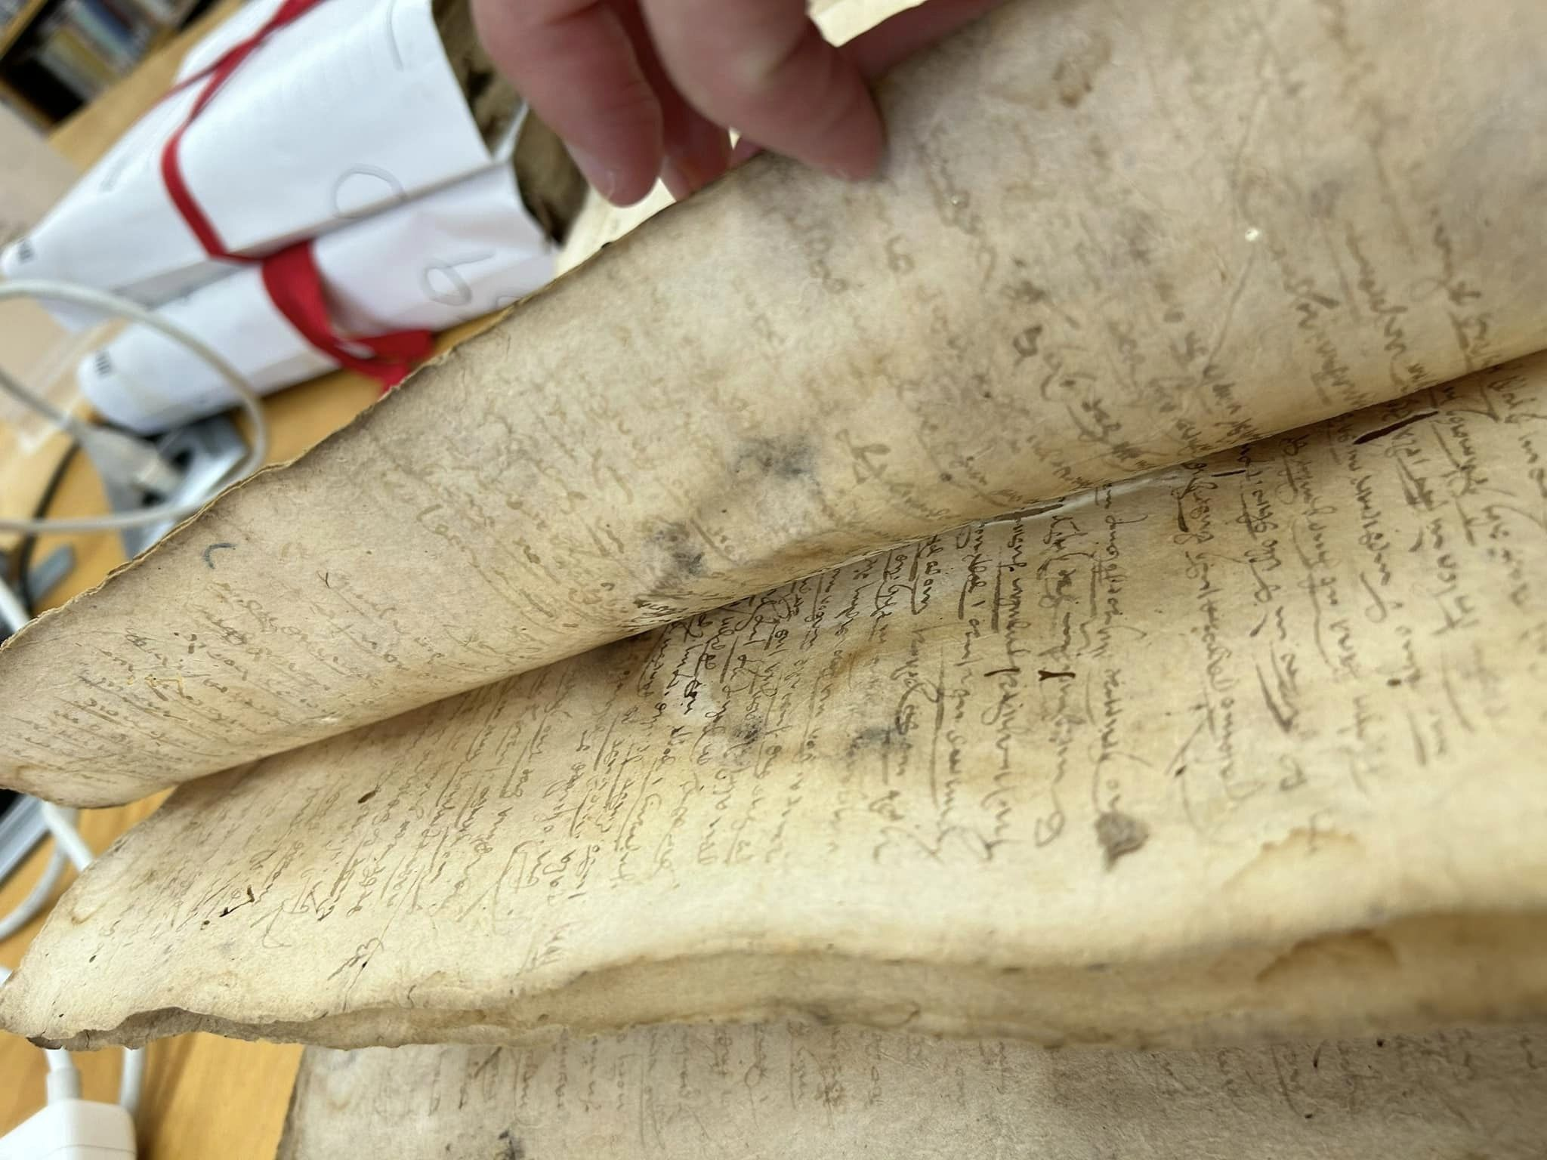
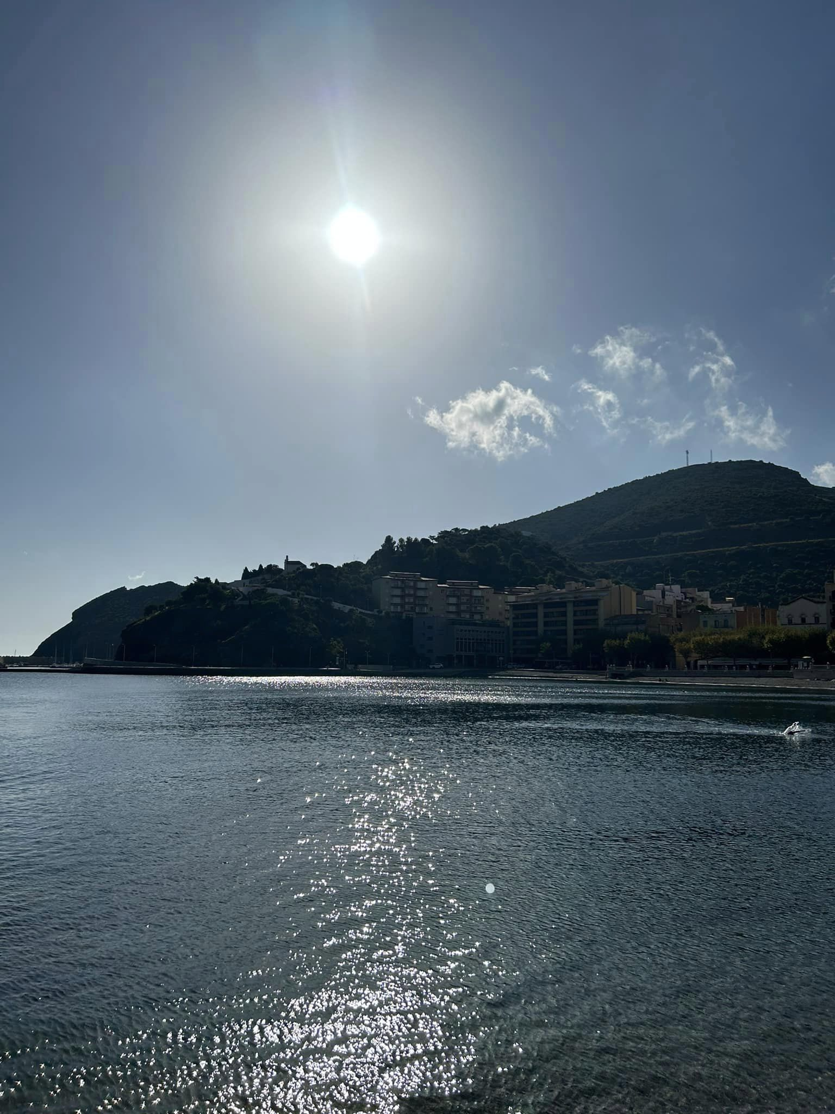
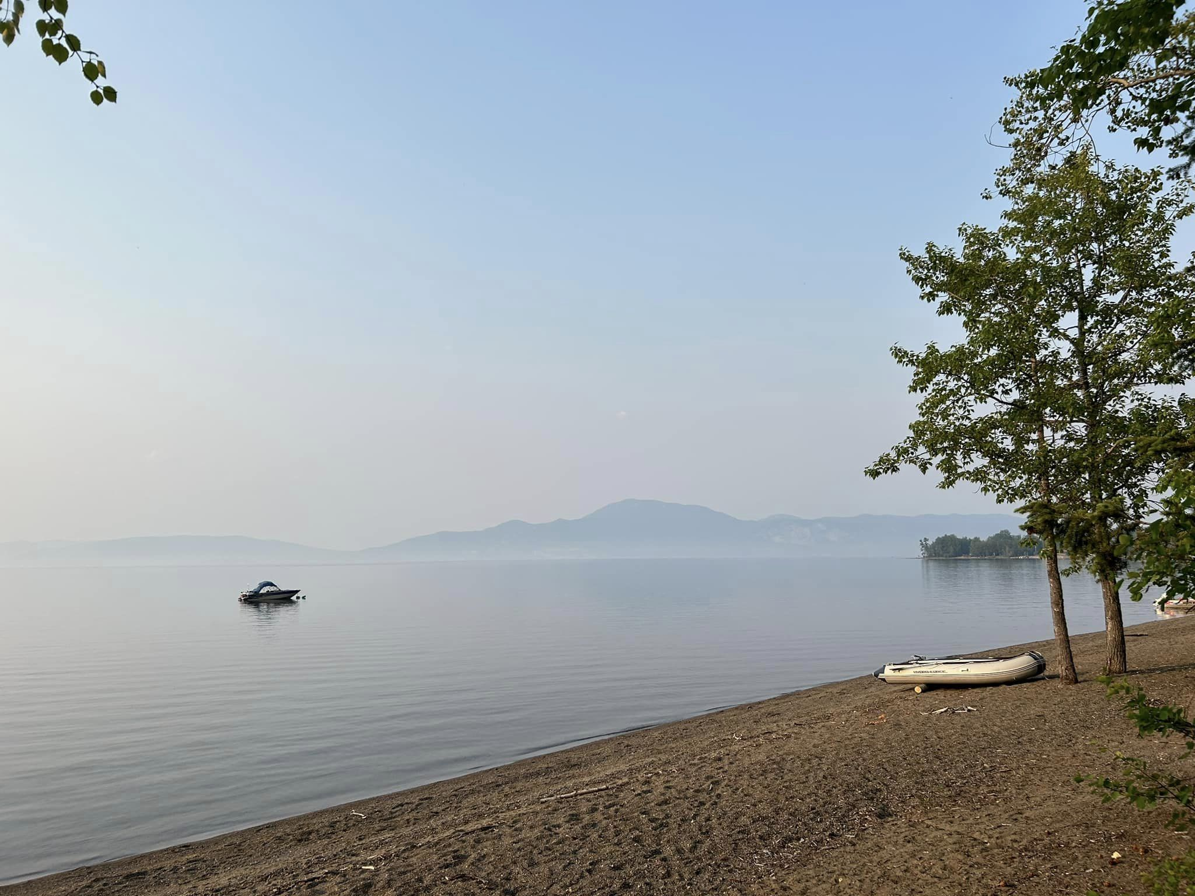
Sabbatical

Slide 9
TEACHING ASSISTANTS (TAs)
Nevada Hinton
Eliane Lieder

Slide 10
HIST 190 – What you need to know!

Slide 11
WHERE? WHEN?

Slide 12
IT DEPENDS!

Slide 13
LECTURES
Lectures: Mon/Weds 10:30-11:20 a.m.
Optional Readings (free open-source textbook)

Slide 14
TUTORIALS
Tutorial readings
Monday or Wednesday
Posted for each week in the modules section on our course website
Mon @ 11:30
Mon @ 5:30
Wed @ 11:30
Wed @ 4:00 (note this is changed from the original schedule)

Slide 15
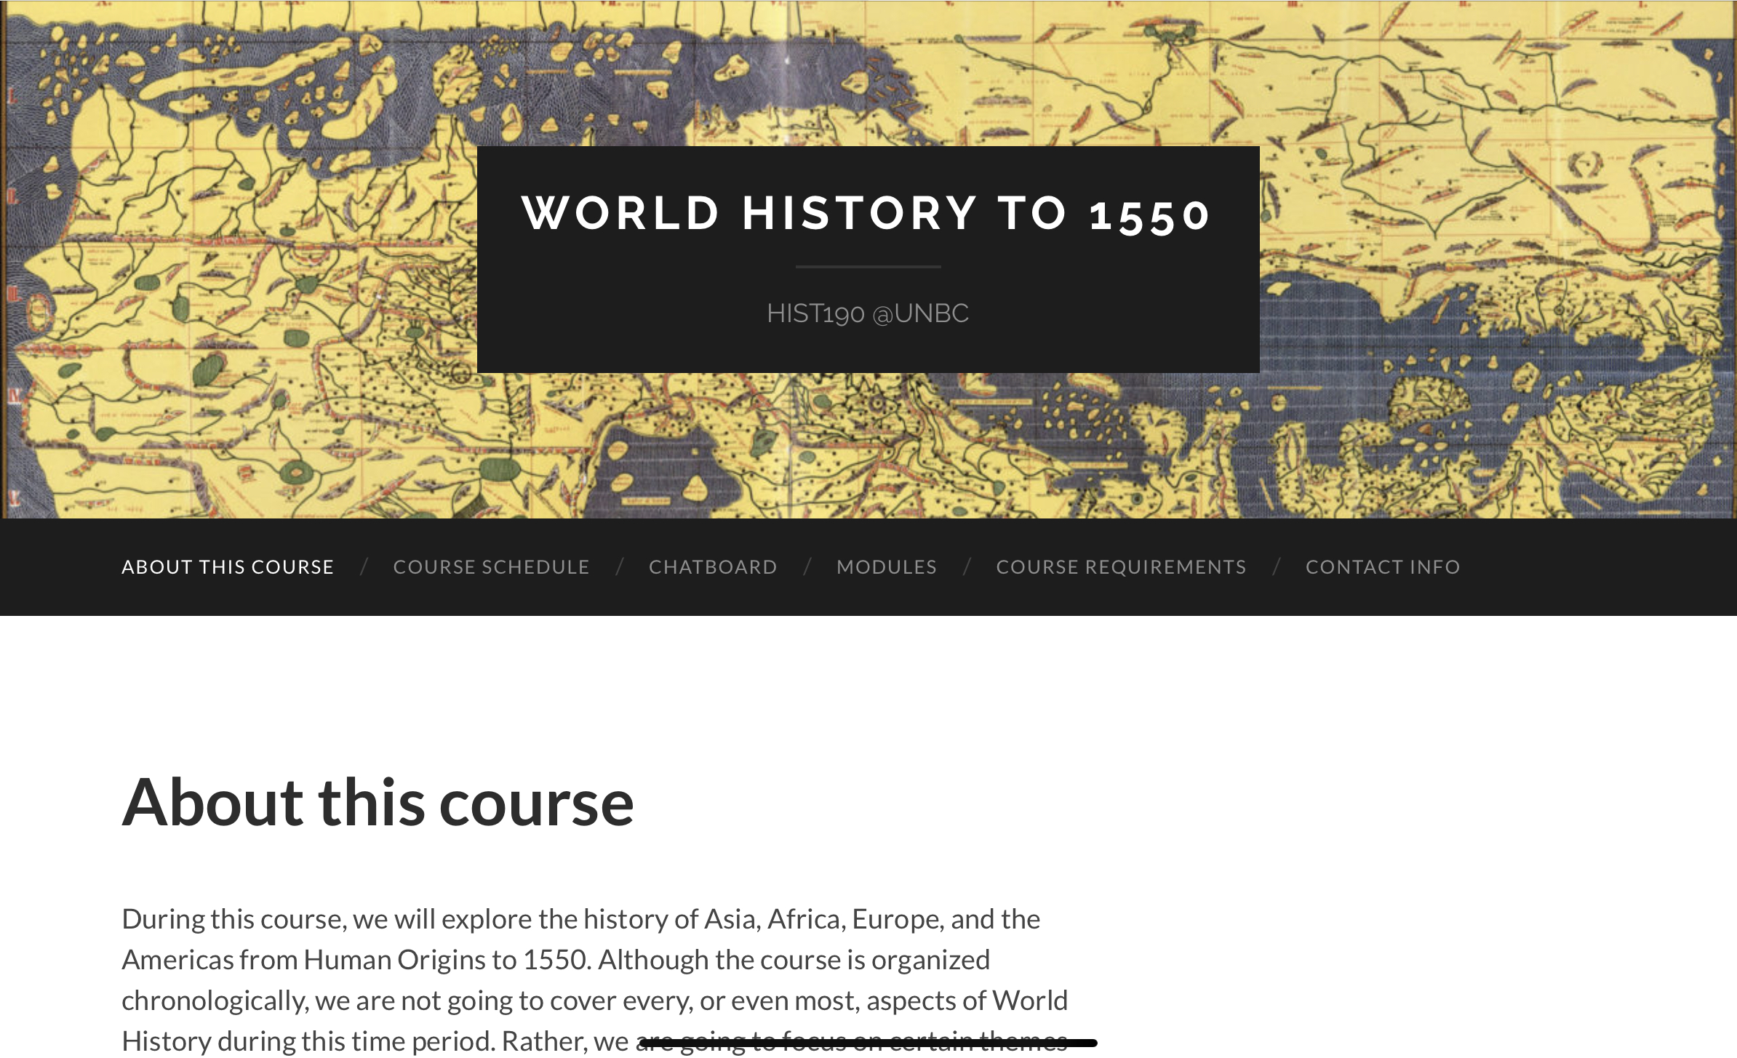
How do I find our course?
Course website:
hist190.opened.ca

Slide 16
Chatboard

Slide 17
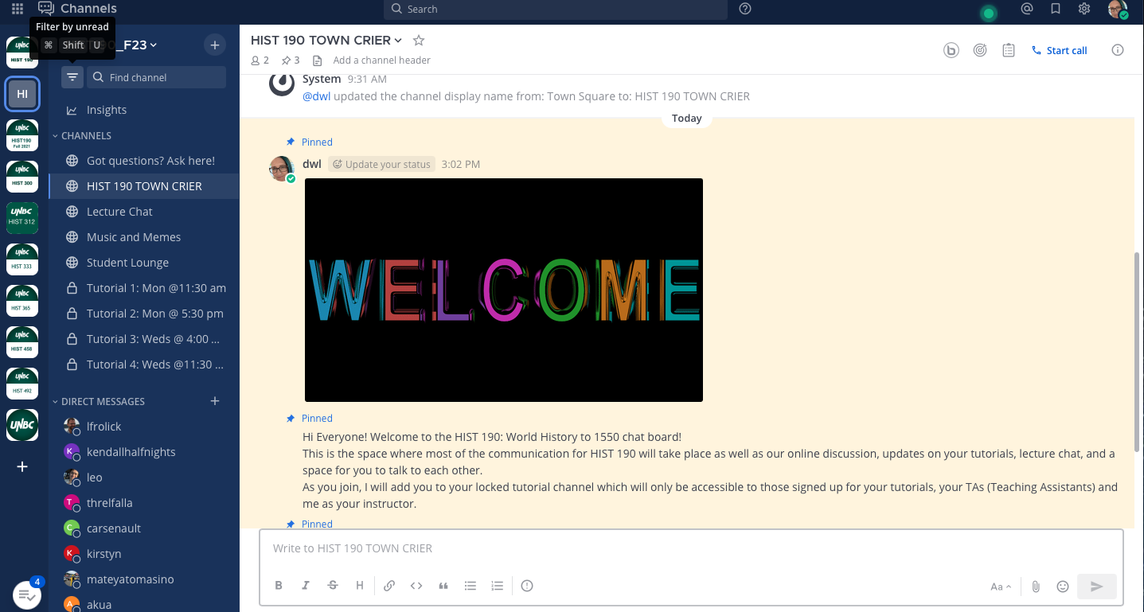
@dwl

Slide 18
Assignment Submission

Slide 19
HIST 190 – What you need to know!

Slide 20
WHAT?

Slide 21
What is World History?
“…everything ever done or imagined.”

Slide 22
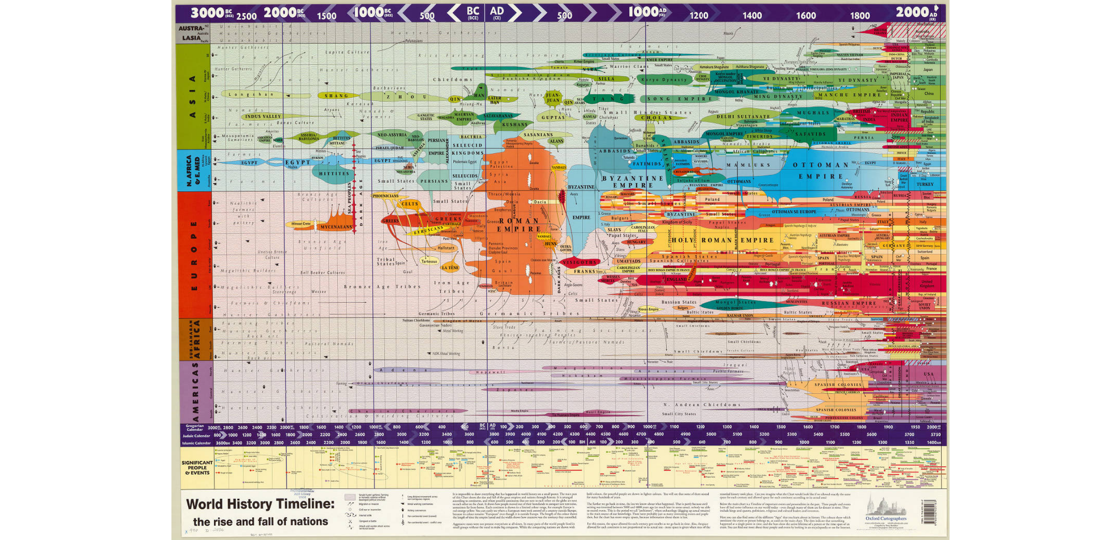

Slide 23
100 000 BCE to 1500 CE
HISTORIA
“A narrative or story of past events”

Slide 24
Historical skills
Read/write/think critically
Primary and secondary sources
research

Slide 25
HIST 190 – What you need to know!

Slide 26
WHAT DO I NEED TO DO THIS WEEK?

Slide 27
Homework
ONE
TWO
THREE
FOUR
FIVE
Visit the Course website hist190.opened.ca
Fill out the posted survey (in the Modules section of the website).
Sign up for the chat board (check your UNBC email)
Sign up for your Research Assignment (Course Requirements->Research Assignment->Step One->Sign up for your topic->VISIT ME IN MY OFFICE McCaffray Hall/Admin 3010)
Check out your tutorial channel on the chatboard, introduce yourself, and ask a question for myself, Eliane, or Nevada

